Slide 1


Slide 2

THE INDUSTRY’S LARGEST PROVIDER
OF END-TO-END SUPPLY CHAIN SOLUTIONS

Slide 3

SUPPLY CHAIN ANALYTICS
End-to-end package intelligence for your entire distribution lifecycle

Slide 4


Slide 5


AI-Powered Image Recognition
& Package Intelligence
  Capture real-time images as packages move through your scanning tunnels
  Browse a searchable database of package images and dimensions from across your entire supply chain
  Get actionable dashboards on the DC floor—when and where they’re needed
  Run reports at the package, tunnel, facility
  or enterprise level

Slide 6
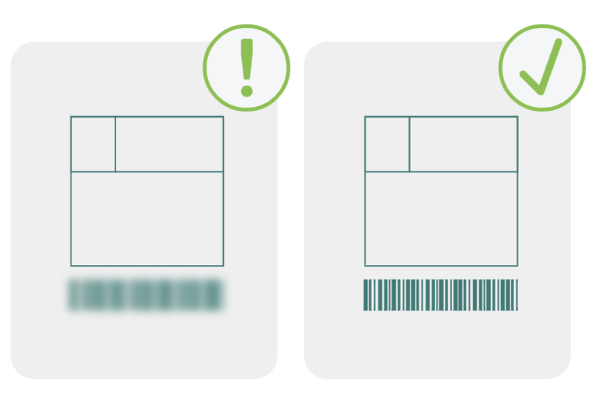

Vendor Compliance
Share tunnel images with Vendors
Identify and classify problem packages
Apply deep learning and automate escalation procedures
DC Maintenance
Remote monitoring of scanning performance
Customizable AI reporting and alerts for anomaly detection
Powerful search and export for all barcodes and dimension attributes

Slide 7

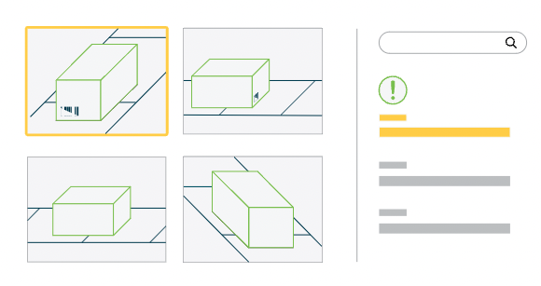
Automate sorting
and exception handling
AI investigates mislabeled boxes,
freeing line work for shipping
Empower quality assurance teams
A searchable database of all package images across your supply chain

Slide 8
Peak Analytics Performance Levels
Consolidated Business intelligence & Data Warehouse
BY THE NUMBERS
200,000+
Sites Deployed
1000+
Tunnels Connected
50 Million+
Packages scanned/Day
2 Billion
Images Captured/Day
50 Million+
AI Inferences
1 TB+
Package data indexed/Day
5 PB
Images Indexed
3

Slide 9
Peak Analytics Business Impact
In Operating Profits
By enabling automated vendor compliance
and corrective actions with Peak Insights
75M

Slide 10
How does it help?
Inventory Management
Track packages in real time, across multiple facilities​
Warehouse Operations
Gain complete visibility into day-to-day operations at each tunnel in the facility​
Vendor Compliance
Zero in on issues related to faulty packages​
Maintenance & Engineering
24/7 monitoring of the facility , enabling pro-active maintenance of critical systems​

Slide 11
Our Products

Slide 12

Learning Insights
First of its kind no-code complete
AI Platform for Logistics
Capture, label and store vendor agnostic images
Train & Deploy AI/ML models
Add intelligence to accelerate your business outcomes

Slide 13

Facility Insights
Identify systemic issues for supply chain planning
Dashboard view of all scanning tunnels in facility
Customizable AI reporting and alerts for anomaly detection
Powerful search and export for all barcodes and dimension attributes

Slide 14
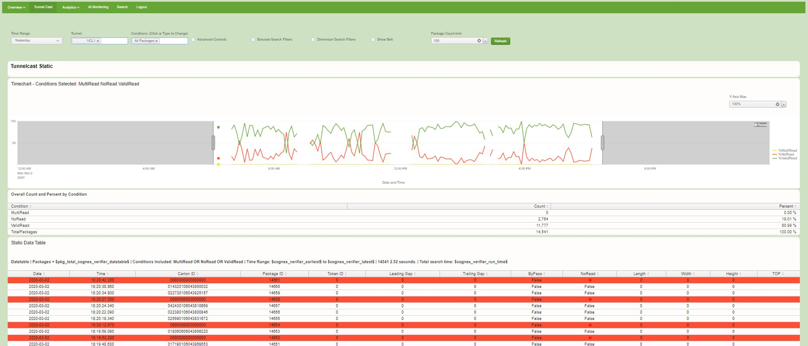
Tunnelcast​ - Facility Insights
Full visibility into package activity for the selected timeframe and tunnel.​

Slide 15
Tunnel Insights
Diagnose maintenance and package
issues faster
Real-time, 6-sided package images and
dimension data
Quick, local access to TunnelView and barcode readouts
Queries, no-read filters and replays by timeframe

Slide 16
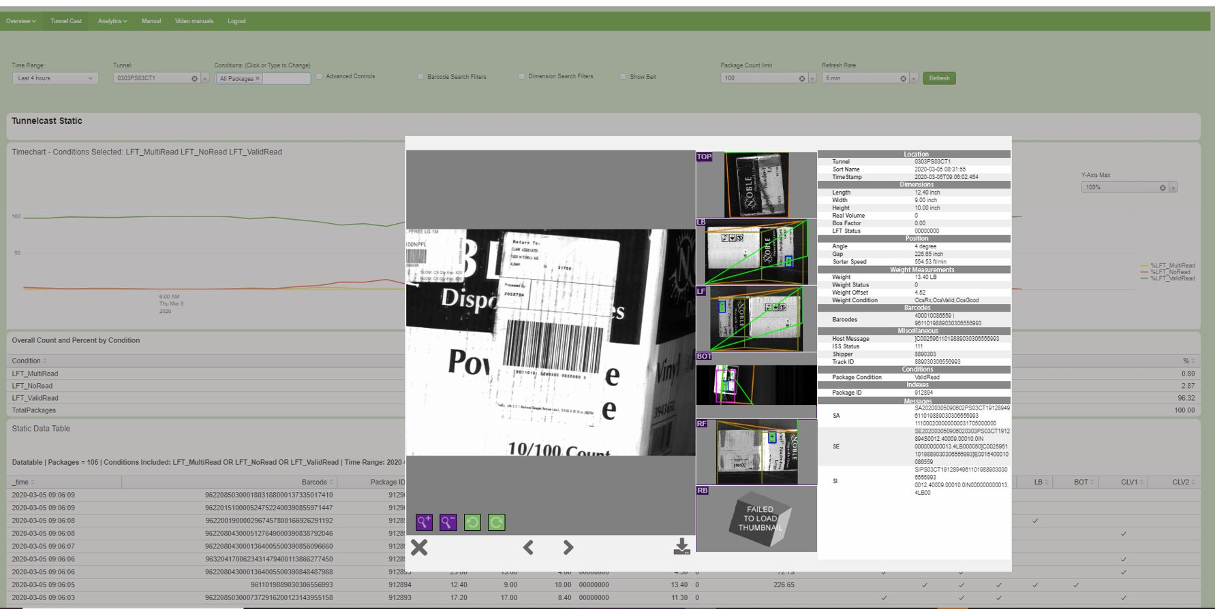
Tunnelcast​
Full visibility into package activity for the selected timeframe and tunnel.​

Slide 17
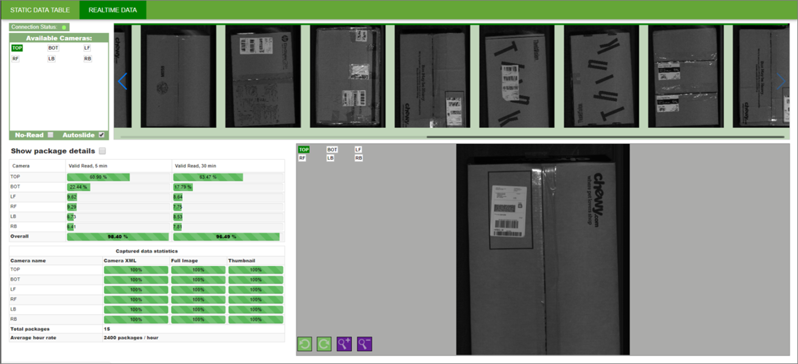
Realtime Data​ - Tunnel Insight
Detailed insights of packages as they move on the conveyor belt in real-time.

Slide 18
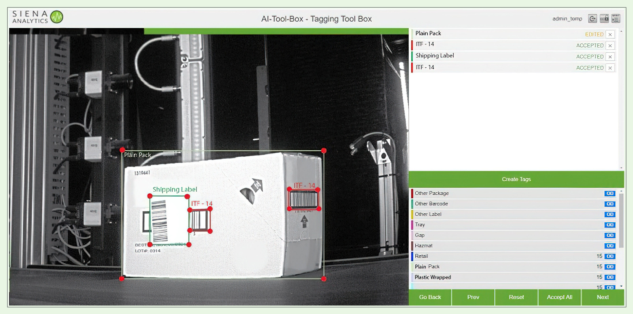
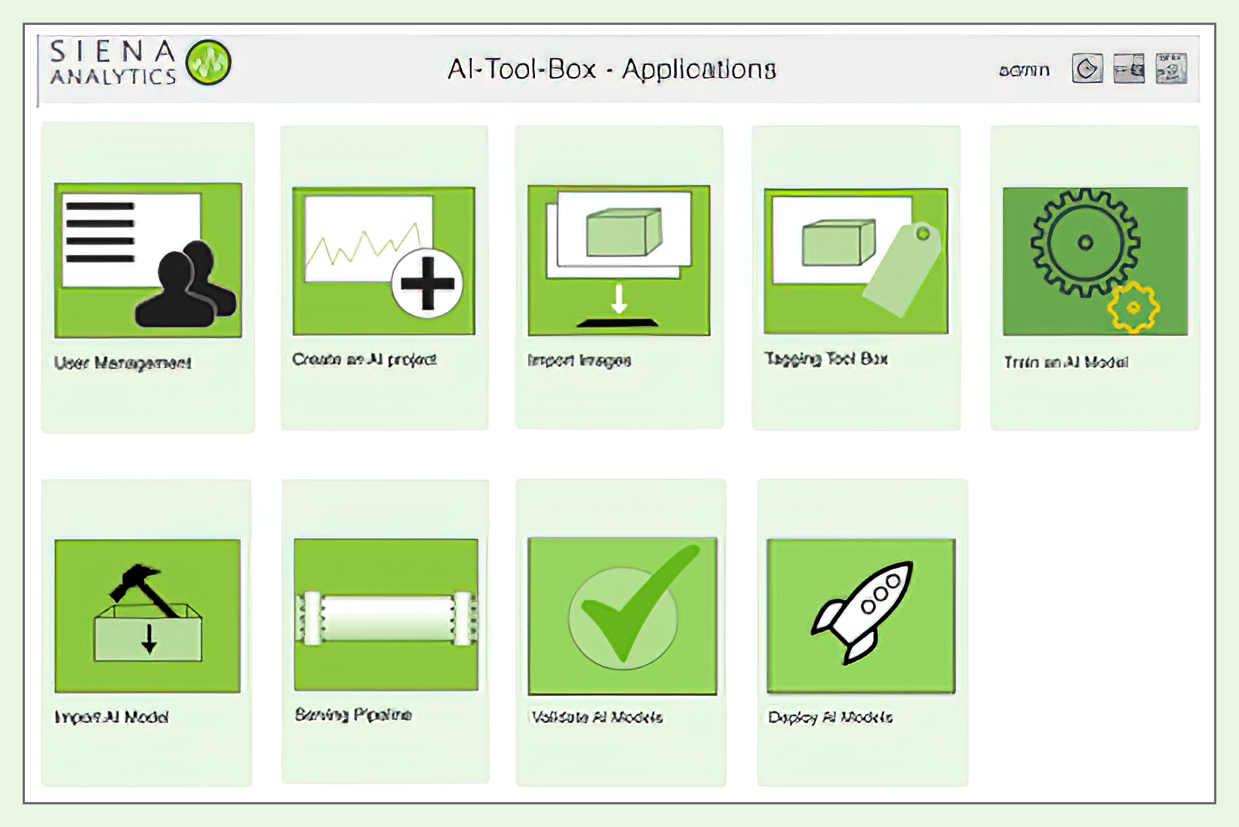
AI Toolbox Application
Create your own AI models with just a few clicks.
CAPTURE
Capture millions of images from any sensor
INTEGRATE
Integrate business logic based on relevant issues
TRAIN & VALIDATE
Build, train and validate AI models
DEPLOY & MONITOR
Deploy finished models to automate visibility
NO CODE END-TO-END AI

Slide 19
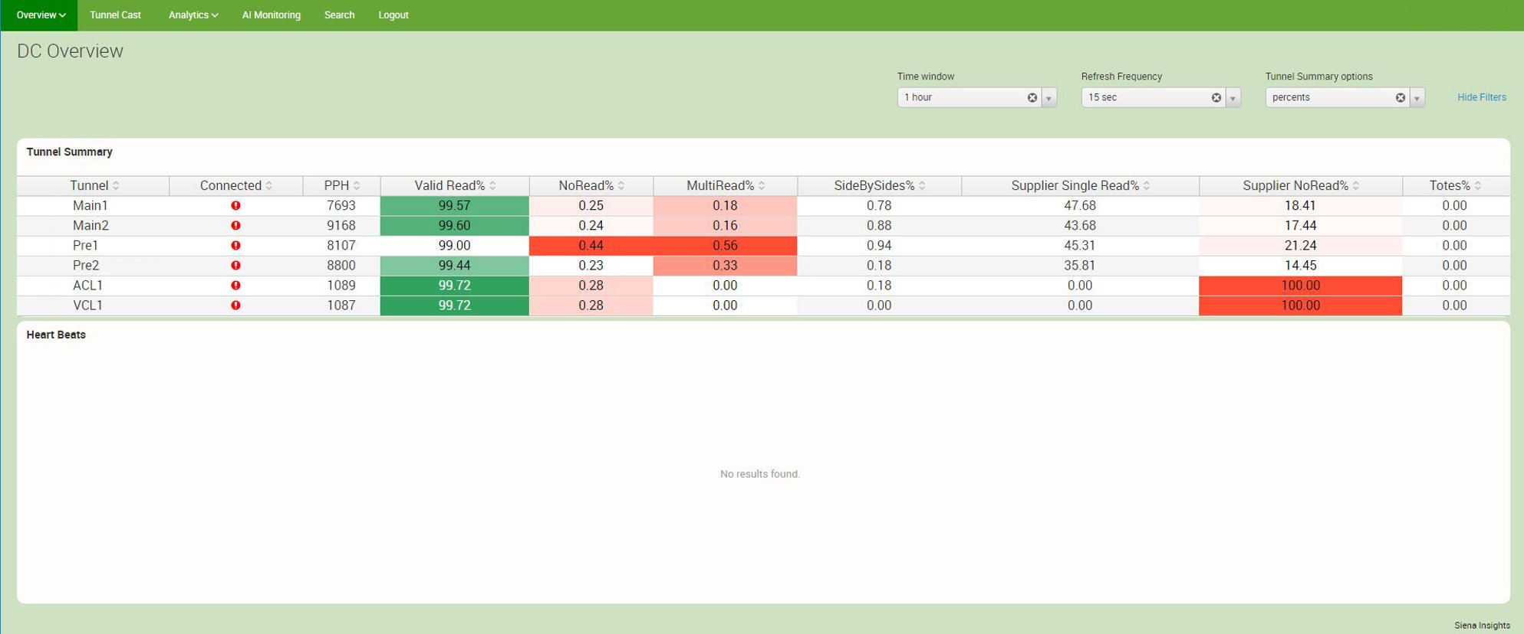
DC Overview
Provides a comprehensive summary on package activity across all tunnels​

Slide 20
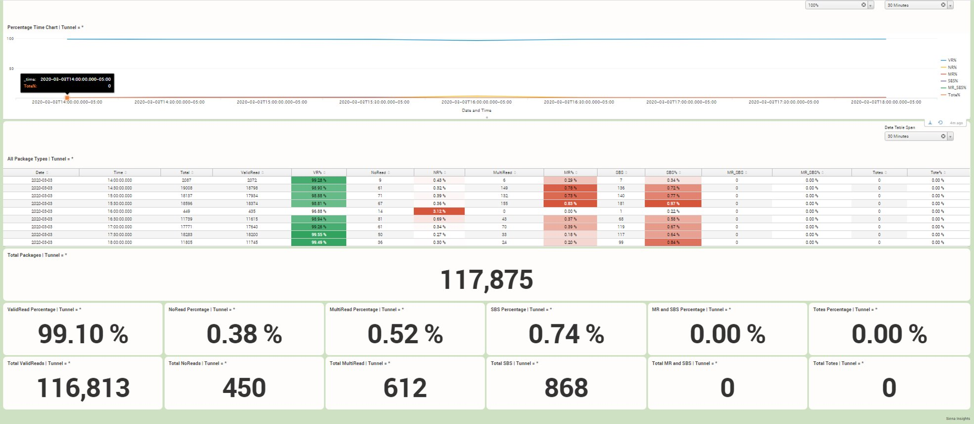
Totals
Provides various package specific information per tunnel over a specific time span.​

Slide 21
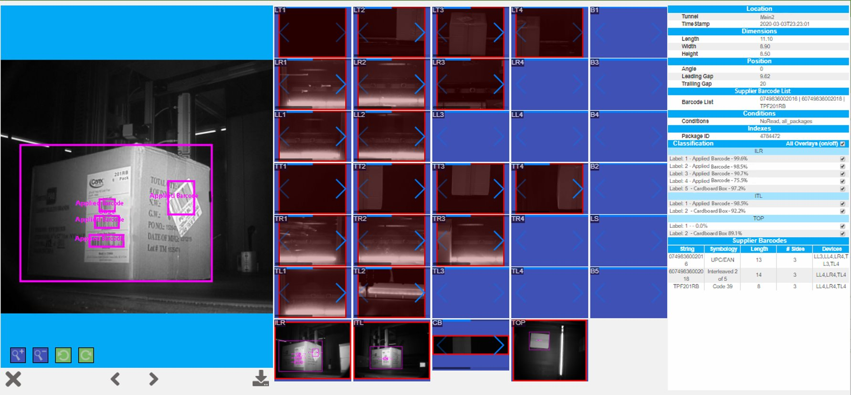
iViewer
Displays Multiread & Side-by-Side data for a given time range and tunnel. ​

Slide 22
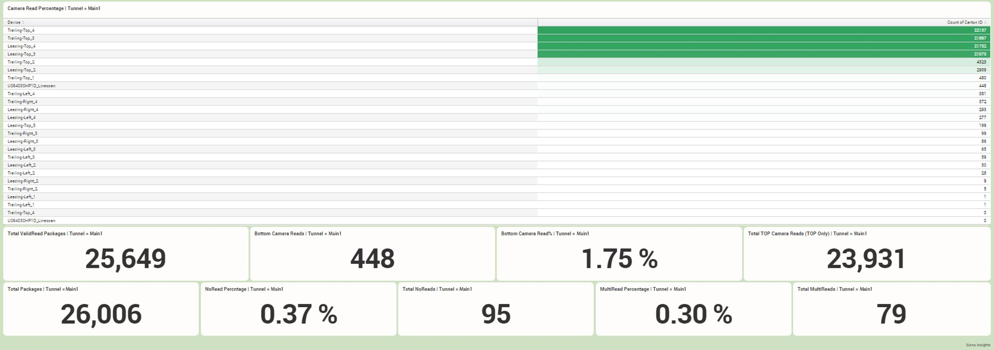
Device Performance
Displays the count of barcodes read by each camera for a given time period, and useful totals. ​

Slide 23
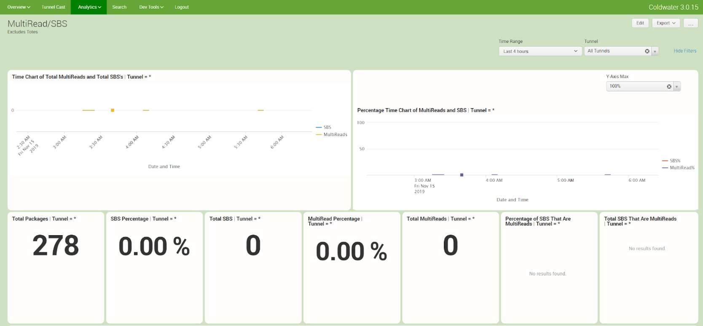
Multiread/SBS(Side-by-Side)​
Displays Multiread & Side-by-Side data for a given time range and tunnel. ​

Slide 24
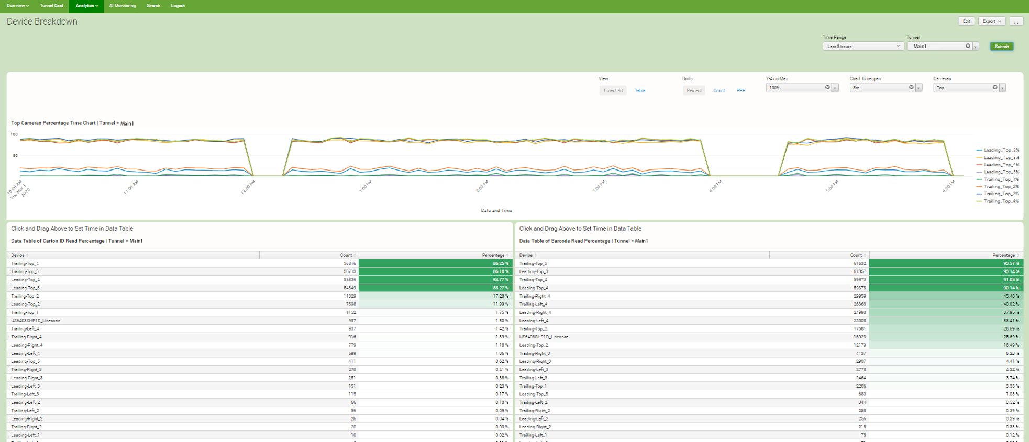
Device Breakdown​
Displays the percentage of a given barcode type read by each camera. ​

Slide 25
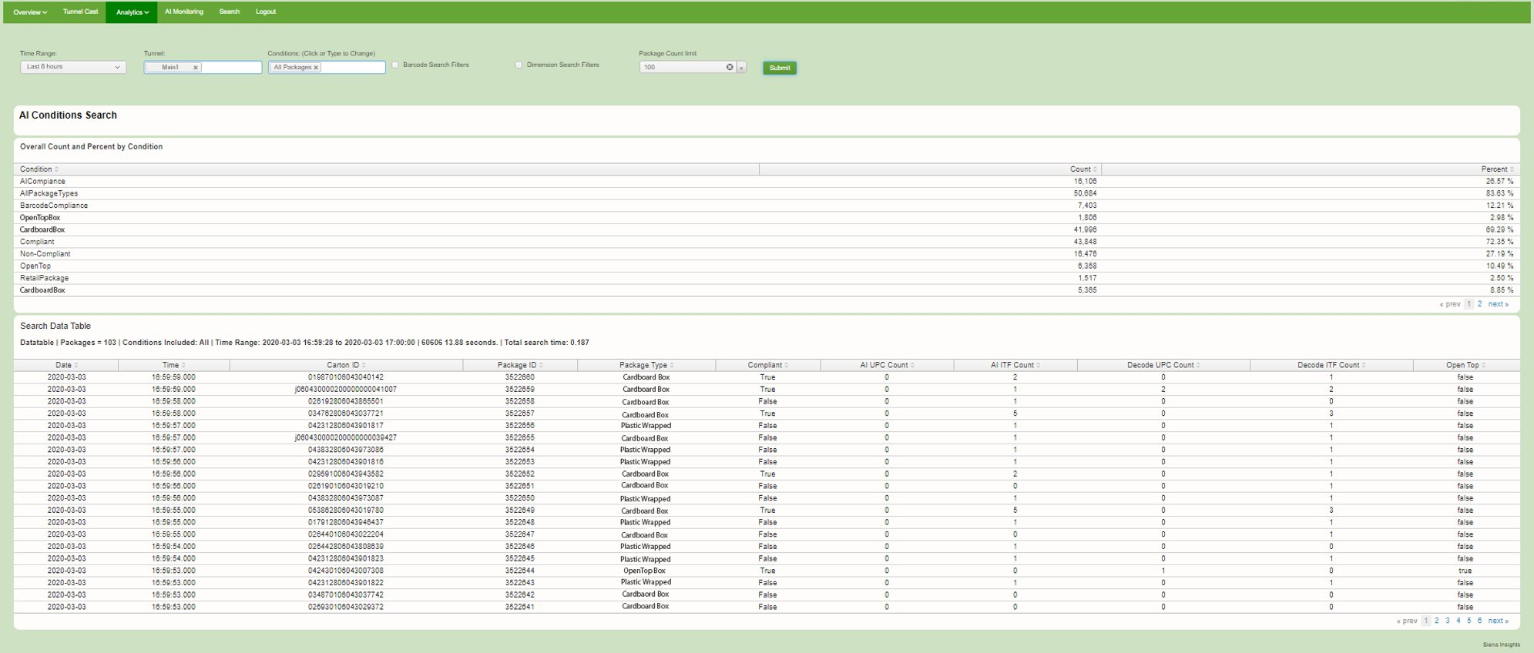
AI Conditions​
Provides details about packages based on specific conditions. ​

Slide 26
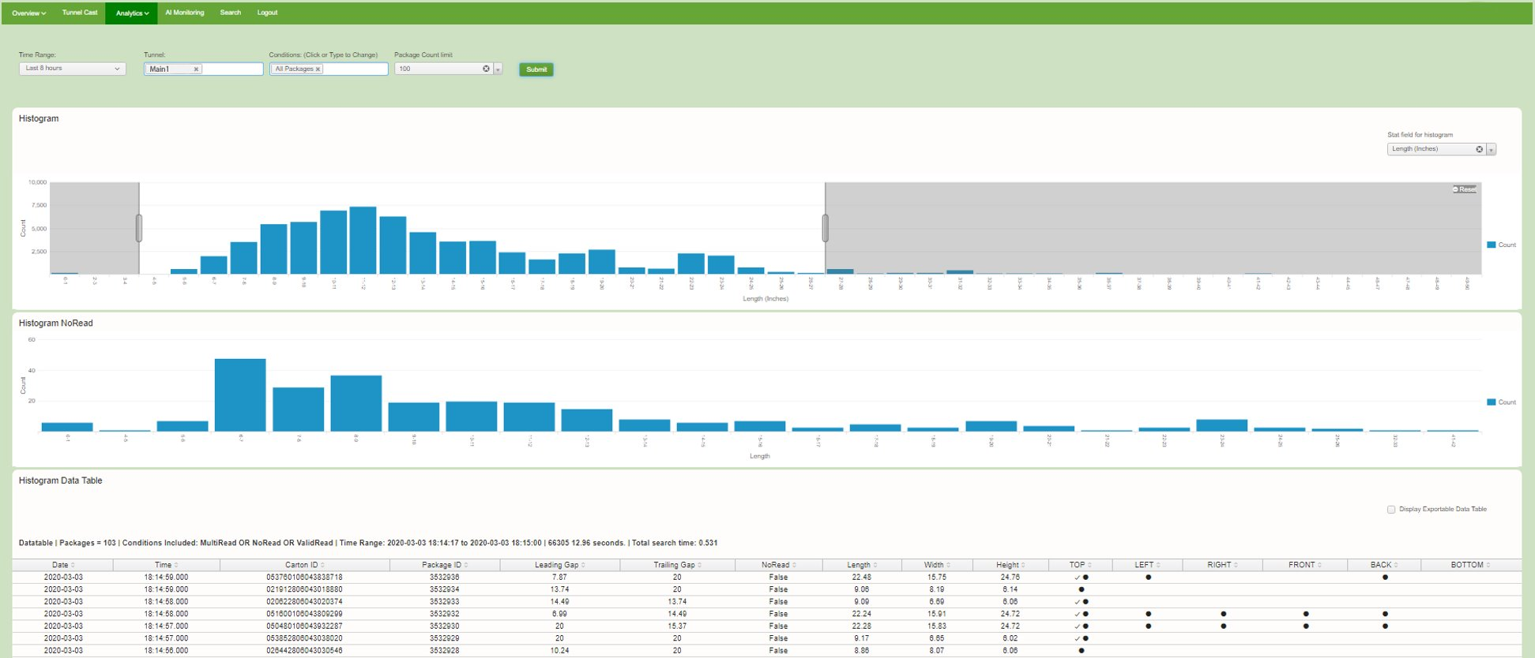
Histogram​
A powerful dashboard that displays the volume of packages based on specific parameters such as length, gap between packages, etc. ​

Slide 27
See the software in action
Currently deployed in over 200+ buildings across various locations in America.

Slide 28
Ready to automate your distribution center?
Currently deployed in over 200+ building across various locations in America.

