Slide 2
Commanding Officers for Today
Dwayne Chapman
Doug Houser
Raul Sam
Service Account Manager
Sr. Business Development Manager
VP, Depot Service
21 years with Peak
32 years service delivery and sales experience
Currently supports: Onsite Services Sales, Managed Services Sales
10 years with Peak / DBK / Avalon
~40 years in the Auto ID space in numerous sales and marketing capacities
Currently supports: Driving volume into Peak Depot network
20 years with DBK / Peak
25+ years in Operations, repairs delivery, Information Technology and Enterprise Architecture.
Currently leads: Depot Repairs operations
Welcome ROBERT TODD
16 years at Ricoh USA with roles managing end-user training, technology services, and field operations
Currently Supports: Professional Services (Wireless Site Surveys, Applicators, Cognex/Machine Vision)
Manager, Pro Services

Slide 3
Mission Objectives
Understand how selling Depot / Field / Pro Services is CRITICAL TO REALIZING OUR VISION
Understand WHAT Depot / Field / Pro Services we support
Understand HOW to sell Depot / Field / Pro Service
Understand the IMPACT selling in Depot / Field / Pro Services can make to your bottom-line GM$, GM%, QUOTA RELIEF, AND COMMISSIONS

Slide 4
DEPOT SERVICE

Slide 5
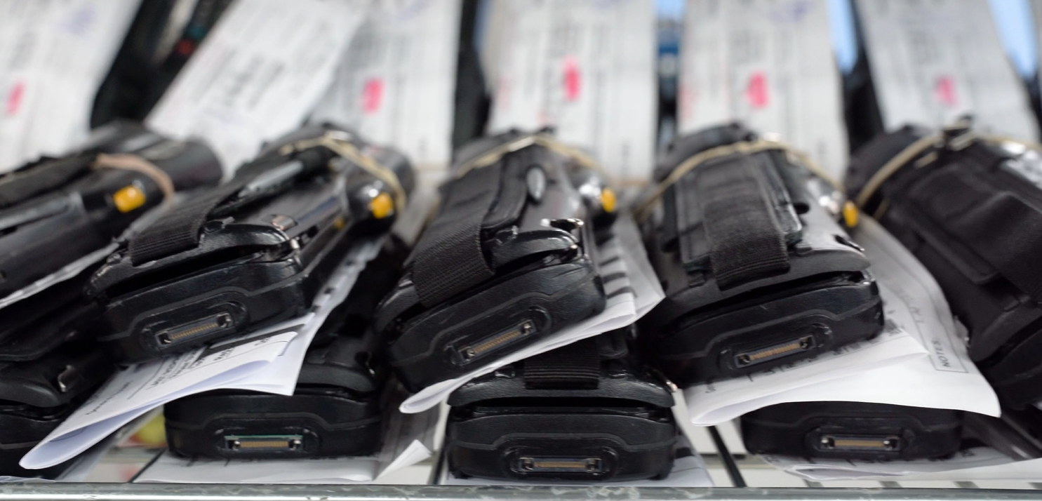
VIDEO DBK Depot Service 2.5 Min

Slide 6
Depot Service Capabilities
DEVICE REPAIR
250+ technicians with facilities in Miami & Minneapolis
50K+ SQFT of combined repair capacity
1,500+ repairs daily with capacity to grow
Repair portal capability with 24x7x365 status visibility
Broad repair and reimage scope of devices from handhelds, to printers, to servers, to Android and iOS phones
Multiple connection paths: customer direct, sub-contract for OEM, white label as OEM, contract or T&M
REFURBISHED HARDWARE
Peak is your first call every time for refurb gear
Decades of combined experience sourcing hard, restoring, and reselling refurbished gear
The Depot team can offer end-of-life options during refreshes to offload old gear Example: Moving from T72 to T78, great potential for giving the customer credits for the T72s as part of the refresh deal – win for you, win for Peak, win for customer!

Slide 7
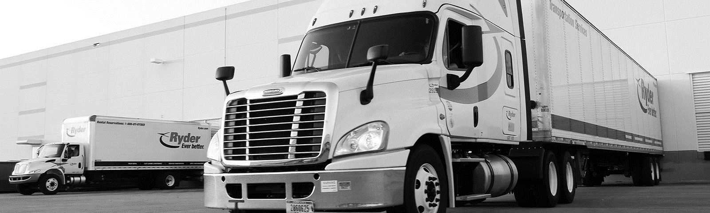
You may think of Ryder as just truck rentals, but they do so much more from dedicated fleet to warehousing to supply chain services
A 20 year customer originating at DBK, Peak has sold them handhelds, printers, media, access points, custom kiosks, fleet telematics, and break fix services
GREAT example of expanding out of the traditional AIDC with a full Depot service wrap to keep it easy
Peak Depots can repair each of these different portfolio components as allowed by the OEM partners
Opportunity to increase total revenue and gross margin on your sales

Slide 8
DEPOT SERVICE CRITICAL INFO TO QUOTE
Customer
Product / Model
Zip Code / Location
Quantity
Current Warranty Status
Type of Service (T&M, Contract, TST)

Slide 9
FIELD SERVICE

Slide 10
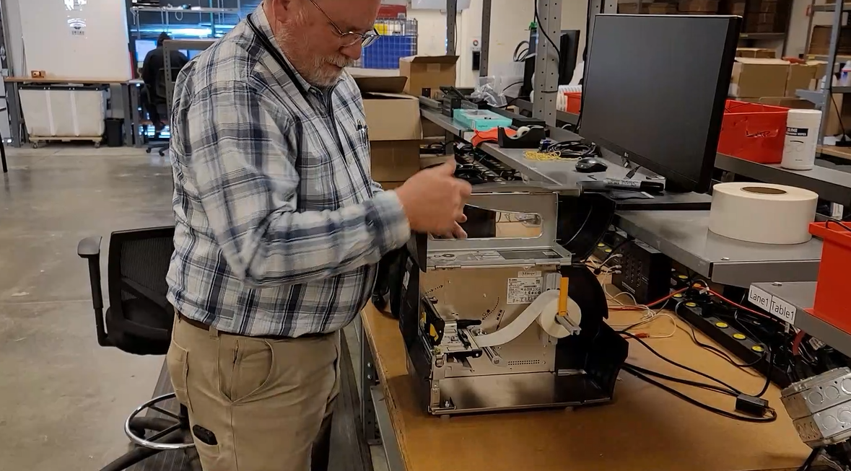
FIELD AND PRO SERVICES VIDEO (1.5 min)

Slide 11
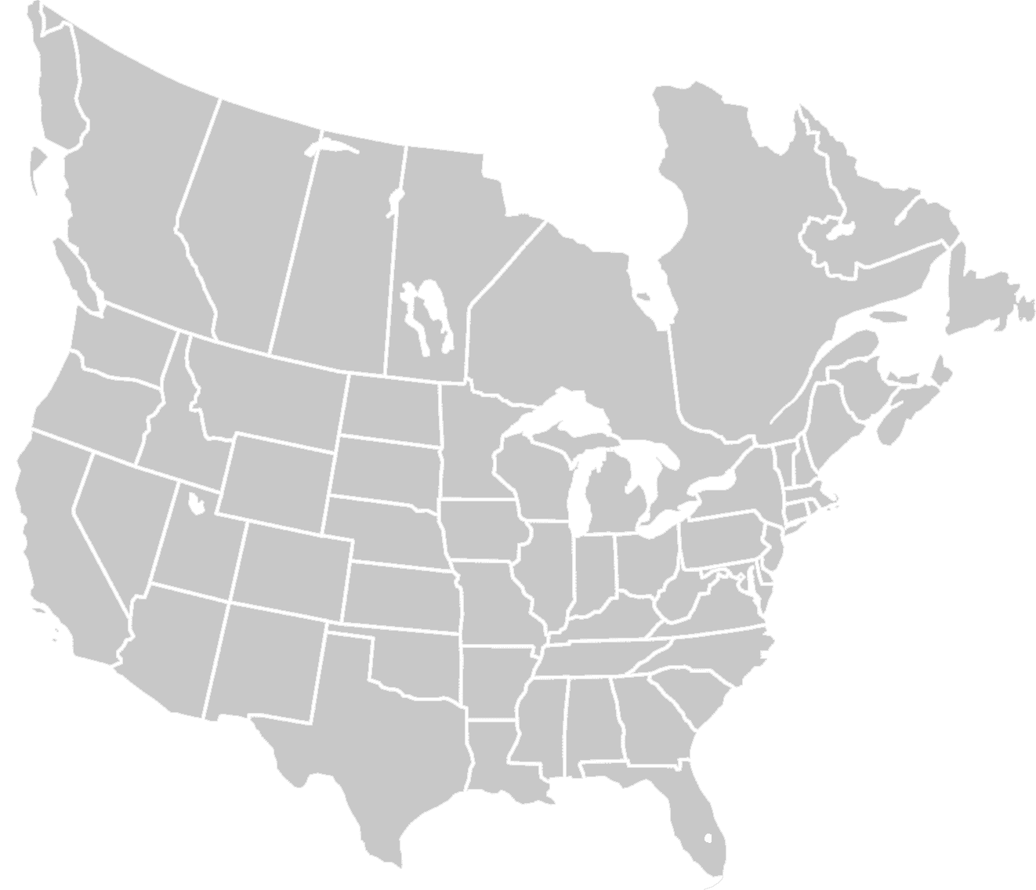
Peak Field Services
Team Overview | ~150 Strong!
140 Peak Service Technicians
7 Regional Service Managers (RSMs) monitor daily execution – MEET THEM THIS WEEK!
94% calls completed by W2s across US & CAN
Average 17 years Experience
Factory Trained & Certified
Peak can white label as TST
Big opportunity to increase average margin!

Slide 12
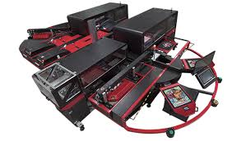
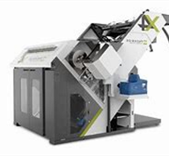
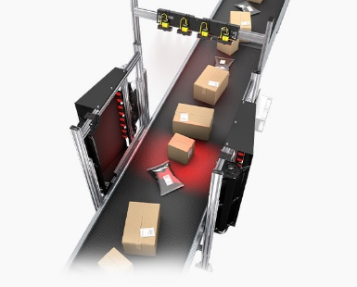
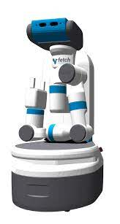
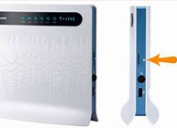
Field Service Capabilities
PRINTER REPAIR
2,000+ Models
Laser / MFPs/ Color
Inkjet
Direct Thermal
Thermal Transfer
Continuous Form/ Line
Card Printers
Dot Matrix/ Impact
RFID
Print and Apply
Print Engines
Power Carts
SOLUTION IMPLEMENTATION
Hardware Integration
Installations / Upgrades/ Refresh
AIDC Imaging / Go-Live / Upgrades
Equipment Swapping
Asset Tagging / UID
Vision Tunnel Installations
Locker Installations
SIM Card Swaps
Have a Need for an ONSITE PRESCENCE? ASK!

Slide 13
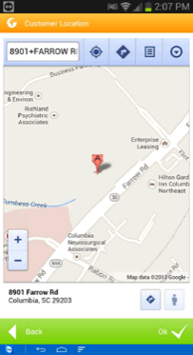
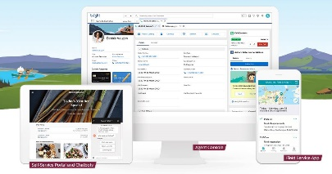
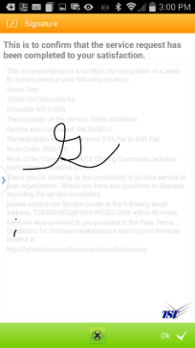
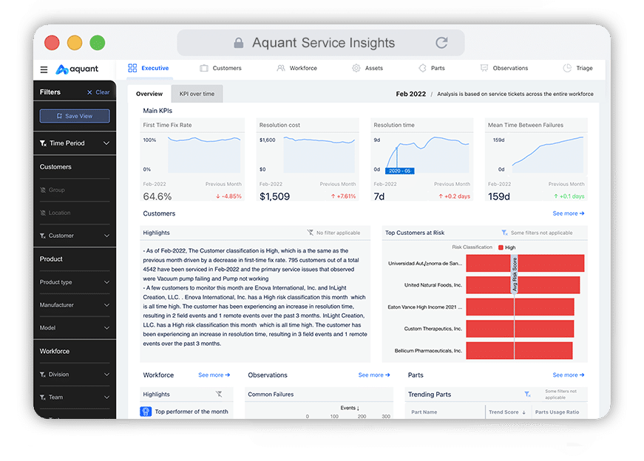
Service Delivery You Can Trust
Net Promoter Score: 85% (EXCEPTIONAL)
High Focus on Routine Execution:
Open Calls & Customer SLAs reviewed daily
Automatic escalations based on SLA
System notifications of key events related to service call
Photo of technician provided to customer ahead of visit
Customer signature captured in app
Kicking off next gen platform transformation NOW!
Platform to add new capabilities:
Live Augmented Reality (AR) coaching further broadening team capabilities
Aquant Artificial Intelligence (AI)
Field Service Management through SalesForce
Utilization and Mean Time to Repair (MTTR)

Slide 14
You may think of Toyota as just a car brand, but their manufacturing and supply chain backbone is nationwide and focused on excellence
They are focused on Continuous Improvement and Respect for People – a great cultural fit with Peak
Peak service keeps cars coming off the line!
Large Onsite Service TLS/PDC’s
Multi-OEM Solutions: Zebra / Printronix / Lexmark / HP
Lexmark Monroney Printer Refresh 2020
MPS Lexmark / HP Supplies
PDC HP Refresh with HP Printers
Negotiating Manufacturing Onsite/MPS
RFID Opportunity, Technology PoC May 2023

Slide 15
FIELD SERVICE CRITICAL INFO TO QUOTE
Customer
Product / Model
Zip Code / Location
Quantity
Current Warranty Status
SLA Requirements / Available Times to Service
Type of Service (T&M, Contract, TST)

Slide 16
PRO SERVICE

Slide 17
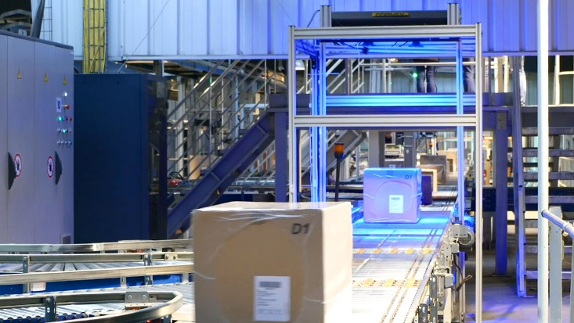
FIS / Machine Vision / Peak Analytics
Supply chain AI and image recognition for high-volume logistics
Peak resources trained and capable of installation and implementation
FXG reference customer with implementation success and ongoing opportunity
All Peak FTEs
Approximately 150 customer engagements in LTM including Walmart, Amazon, Frito Lay, Sam’s Club, and Macy’s
All team members are C1 Certified by Cognex
Some team member are C2 Certified by Cognex

Slide 18
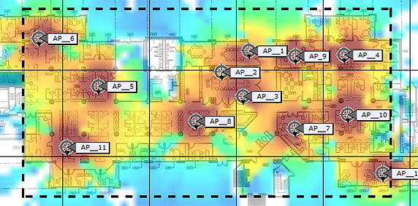
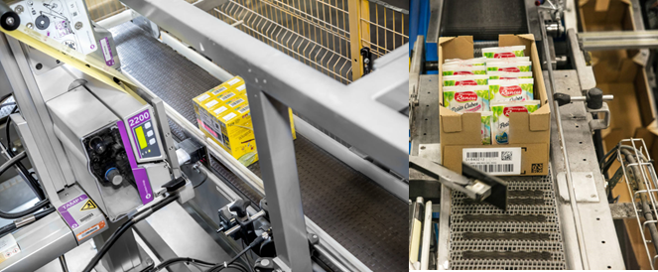
Wireless Site Surveys & Applicator
Wireless site surveys – mapping via software applications
Improved wireless network design – optimal coverage and performance
Accurate performance measurement – signal strength and noise
Optimize wireless network capacity – placement and configuration
Improved accuracy – label application with high accuracy
Increased efficiency – automate the labeling process
Customized label design – meeting labeling requirements
Integration of existing systems – enterprise systems or WMS
Improved traceability – barcodes or QR codes

Slide 19
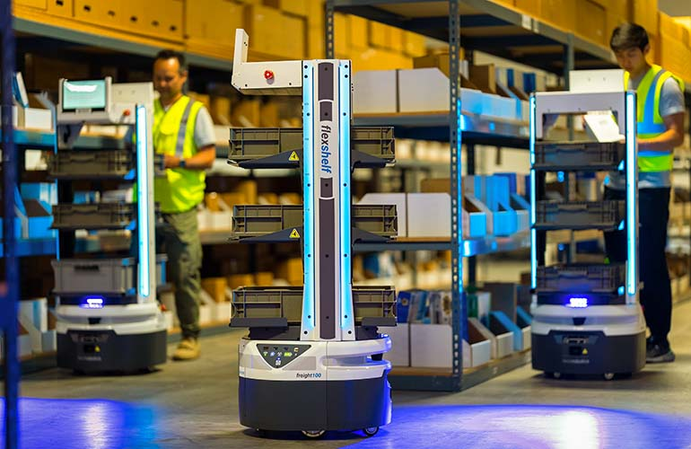
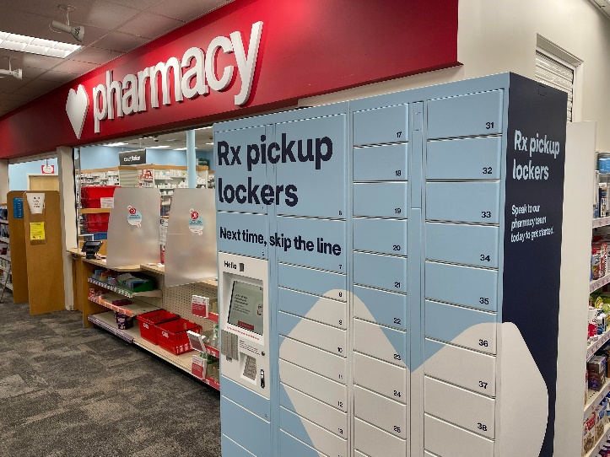
Robotics & Lockers
Improved efficiency – automate repetitive and time-consuming tasks
Installation & implementation
Service opportunity through direct resources and partners
Zebra opportunity – scope and development in process
Existing technical advantages – resources trained and active
Experience with Strongpoint and Telaid – manufacturers and service partners
Service capabilities expanding through existing projects – Kroger, CVS, and BJs.

Slide 20
PRO SERVICE CRITICAL INFO TO QUOTE
Every engagement is different!
For WIFI Surveys: Customer, Location(s), Types of Locations, Accessibility, Due Date
For Lockers, Applicators, Vision – REACH OUT DIRECTLY!

Slide 21
KEY TAKE AWAYS
FIELD SERVICE
DEPOT SERVICE
PRO SERVICE
~150 W2 Field Service Engineers (makes Peak unique in the industry)
Team services 2,000 models from best OEMs
MUCH more than traditional printer repair – how can we help your customer onsite?
250+ W2 Depot Service Team Members (makes Peak unique in the industry)
Team services and refurbishes hundreds of models from all Peak partner OEMs
MUCH more than traditional device repair – iOT, iOS, white label as OEM, etc.
Pre-sales vs. Post-sales alignment SEs upfront in solution design, with a core team delivering the services post-sales
Improved customer experience through high-quality service delivery
Specialized knowledge and expertise will continue to grow and expand
Competitive differentiation leading to increased opportunities, revenue, margin, and commission

Slide 22
Understand the IMPACT selling Managed Services can make to your bottom-line GM$, GM%, QUOTA RELIEF, AND COMMISSIONS
Service solutions are not an upsell, they should be woven into every opportunity as core business.
Solutions Selling leads to increased Revenue in the deal, an improved Customer Experience, additional value through Competitive Differentiation, an extension of the customer leading to Long-Term Relationship, and Higher Margins

Slide 23
Peak Services via DBK
What we can do for you
Doug Houser

Slide 24
Our Agenda
DBK History
Services you can offer to your customers with confidence
Video of your facilities in Miami
Case studies
Q&A

Slide 25
35 Years of Services Excellence
World-class Repair
DBK has grown to over 250 technicians over 2 locations in Miami and Minnesota. Repairing a variety of Commercial and Consumer grade products
DBK Web Portal
Servtrack is the backbone of DBK. Servtrack gives customers a real time view of the status of their repairs as well as allowing them to place RMA’s online 7x24 365 days a year
Logistics & Staging
Superior logistics and staging services, customer support and asset tracking nationwide allows you and your customers to have the confidence and visibility into the vast services we can offer
25

Slide 26
Services tailored to your customer needs
A robust offering unmatched in the industry
Flexible solutions allow you to solve the customers business specific business needs
Depot Repair:
1500 repairs a day currently being done through multiple facilities
Staging and Logistics:
Major companies trust Peak/DBK to stage and deploy Hundreds of Thousands of Devices
USPS, Walgreens, Target, Bass Pro Shops to name a few
Spares Pool Management:
When up time is a must… Advanced exchange and spares pool management ensures productivity never suffers
Recovery call services:
A valuable and often overlooked service that provides great value to your customer that helps them control loss and shrinkage complete with detailed reporting and escalations.

Slide 27
https://vimeo.com/810698731/bd7c590a96

Slide 28
Ryder Systems
DBK Flagship Customer Since 1997
Offering tailored services has allowed DBK to stay “sticky” and added approximately 20% to their yearly spend
Hardware sold and serviced
Zebra Mobile Computers, Tablets and Printers
Lexmark printers
Custom Media
Extreme APs
Custom configured deployed and staged Kiosks
Geotab Fleet telematics installed on 15k devices
Break fix repair staging and logistics a regular service Ryder purchases every year for a variety of projects

Slide 29
USPS
Largest Deployment of devices the industry… ever
Over 380k devices staged and deployed over 18 months
Only 1 day missed in 400 days of shipping….Covid related
Over 1 million items picked and staged go along with the handhelds
Deliveries made to mail carriers locations across the US
Ongoing projects has led to another 40k devices being shipped

Slide 30
✓ Stay sticky with your customers ✓ Have a happier customer base ✓ Lock out your competitors ✓ Use the unique services that only Peak can bring to your customers ✓ Leverage the power ✓ Earn more Commission Dollars$$$$$$$
Depot Service

Slide 31
Questions

